Slide 1

COMP 484 Web Engineering I
Instructor: ~kaplan (akaplan@csun.edu)
Supplemental Slides: HTML

Slide 2
HTML (HyperText Markup Language)
A markup language for creating web pages
Text is marked up with elements delimited by tags
Tags are names contained in angle brackets
HTML5 document contains
A first line indicating the document type
<! DOCTYPE html>
A start <html> and end </html> tag
Nested between the html tags are…
a Head element (<head> … </head>)
Contains a title and other non-rendered doc info
a Body element (<body> … </body>)
Contains the document’s content
Includes text and tags

Slide 3
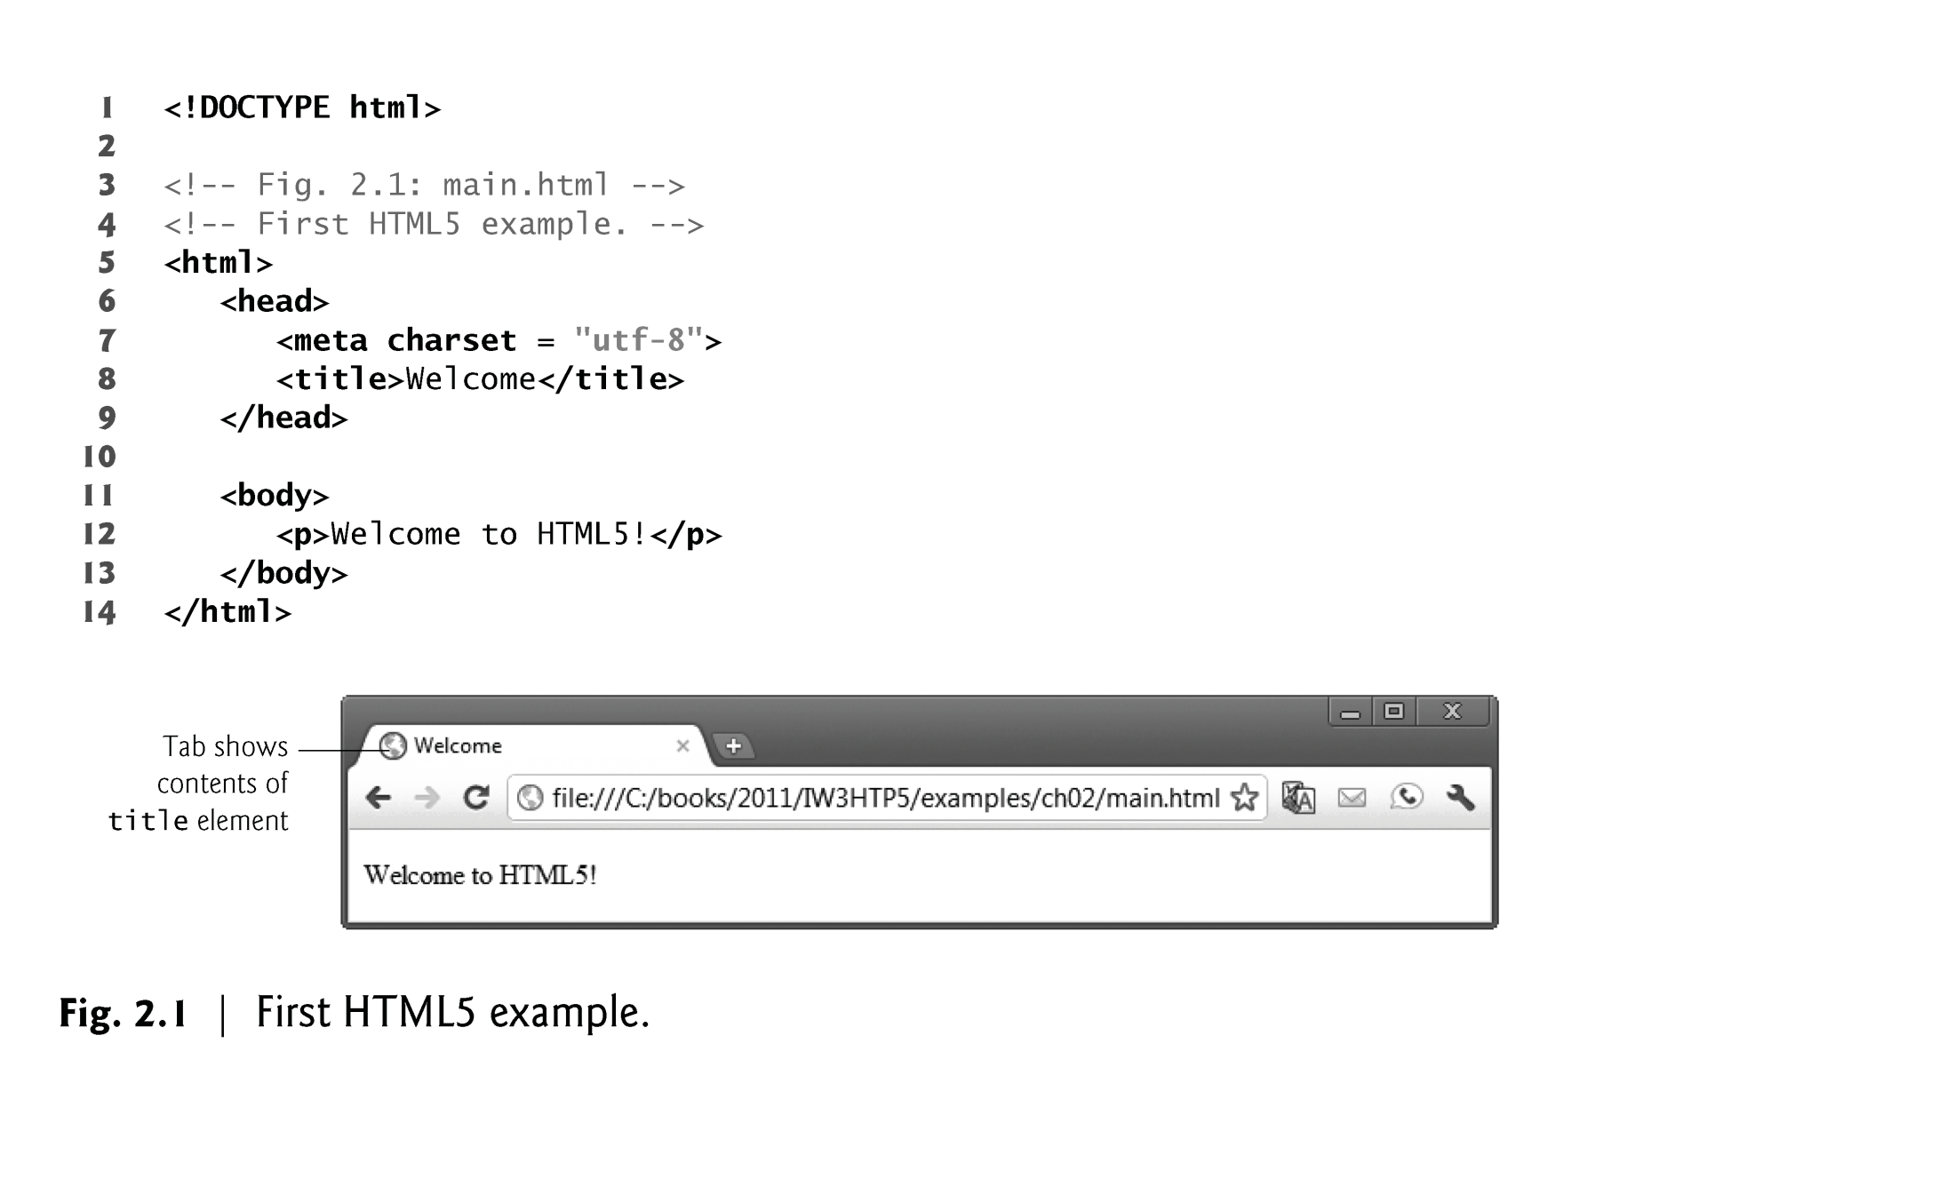
Start Tags and End Tags
HTML5 documents delimit most elements with a start tag and end tag
start tag consists of the element name in angle brackets
<html>
end tag consists of the element name preceded by a forward slash (/) in angle brackets
</html>
Many start tags have attributes that provide additional information about an element
attribute has a name and a value separated by an equals sign (=).
© 2008 Pearson Education, Inc. All rights reserved.
Notes:
Comments in XHTML always begin with <!-- and end with -->. The browser ignores all text inside a comment

Slide 4
The title element describes the web page...
Usually appear in the title bar at the top of the browser window, in the browser tab on which the page is displayed
Search engines use the title for indexing purposes and when displaying results
The title element is called a nested element, because it’s enclosed in the head element’s start and end tags
(The head element is also a nested element, because it’s enclosed in the html element’s start and end tags)
© 2008 Pearson Education, Inc. All rights reserved.
Notes:
UTF-8 is variable width encoding…can represent all Unicode chars…designed for backward-compatibility with ASCII
Dominant character encoding of WWW

Slide 5
Paragraph Element (<p>...</p>)
All text placed between the <p> and </p> tags forms one paragraph.
© 2008 Pearson Education, Inc. All rights reserved.

Slide 6
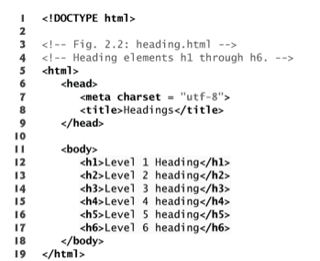
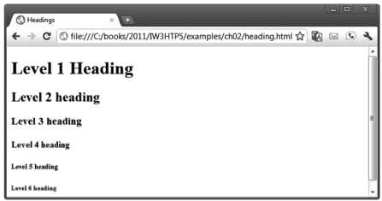
HTML5 provides six heading elements (h1 through h6) for specifying the relative importance of information
Heading element h1 is considered the most significant heading and is rendered in the largest font
Each successive heading element (i.e., h2, h3, etc.) is rendered in a progressively smaller font
© 2008 Pearson Education, Inc. All rights reserved.

Slide 7
Hyperlinks
A hyperlink references or links to other resources, such as HTML5 documents and images
Web browsers typically underline text hyperlinks and color them blue by default
Once clicked, typically change color to purple to indicate “link has been visited”
Links are created using the a (anchor) element.
Attribute href (hypertext reference) specifies a resource’s location, such as
address of a web page (i.e. URL), or location within a web page
a file
an e-mail address
© 2008 Pearson Education, Inc. All rights reserved.

Slide 8
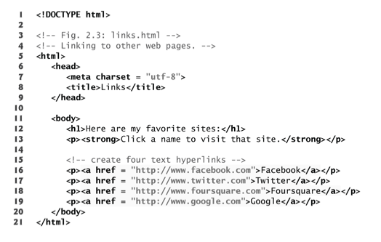
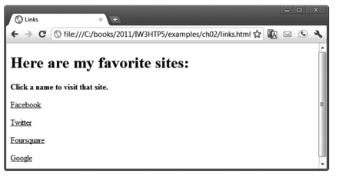
© 2008 Pearson Education, Inc. All rights reserved.
Notes:
The strong element indicates that the content has high importance. Browsers typically render such text in a bold font.
Notice: links are to URL http://www.facebook.com for instance…no trailing forward-slash nor page referenced

Slide 9
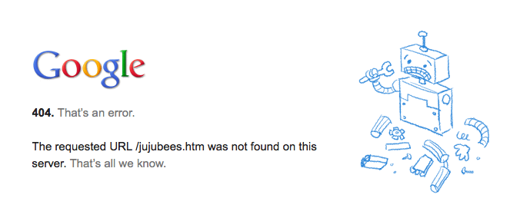
Hyperlinks (cont)
When a URL does not indicate a specific document on the website, the web server returns a default web page.
This page is often called index.html
Most web servers can be configured to use any file as the default web page
If the web server cannot locate a requested document, it returns a 404 error
The browser displays a web page containing an error message.
© 2008 Pearson Education, Inc. All rights reserved.

Slide 10
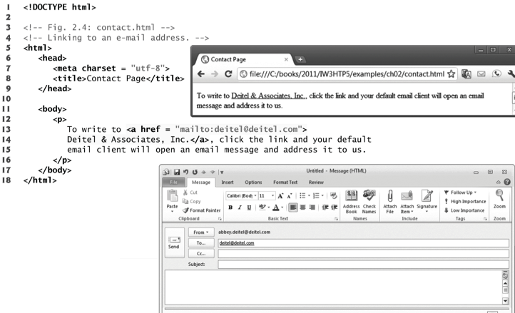
Hyperlinking to an E-Mail Address
Anchors can link to an e-mail address using a mailto: URL
When user clicks, most browsers launch the default e-mail program with the linked address populated in the “To:” field
© 2008 Pearson Education, Inc. All rights reserved.

Slide 11
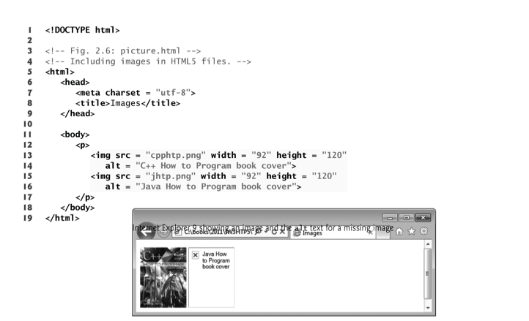
Including Images
The img element’s src attribute specifies an image’s location
In HTML5, every img element must have an alt attribute, which contains text that is displayed if the client cannot render the image
Width and height are optional attributes (measured in pixels)
If omitted, the browser uses the image’s actual width and height
© 2008 Pearson Education, Inc. All rights reserved.
Notes:
The most popular image formats used by web developers today are PNG (Portable Network Graphics) and JPEG (Joint Photographic Experts Group).

Slide 12
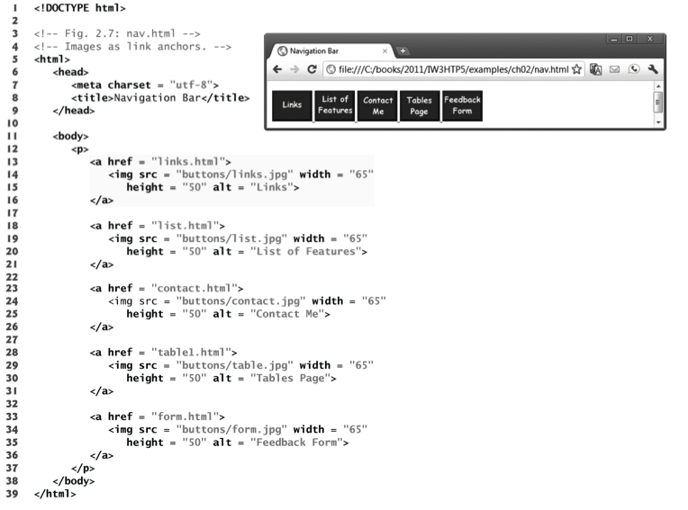
This Example
Uses Images
As Hyperlinks
© 2008 Pearson Education, Inc. All rights reserved.

Slide 13
Lists
Unordered list element ul
Creates a list in which each item in the list begins with a bullet symbol (typically a disc)
Each entry is an li (list item) element
Ordered list element ol
Creates a list in which each item in the list begins with a number
Lists may be nested to represent hierarchical relationships, as in a multi-level outline
© 2008 Pearson Education, Inc. All rights reserved.

Slide 14
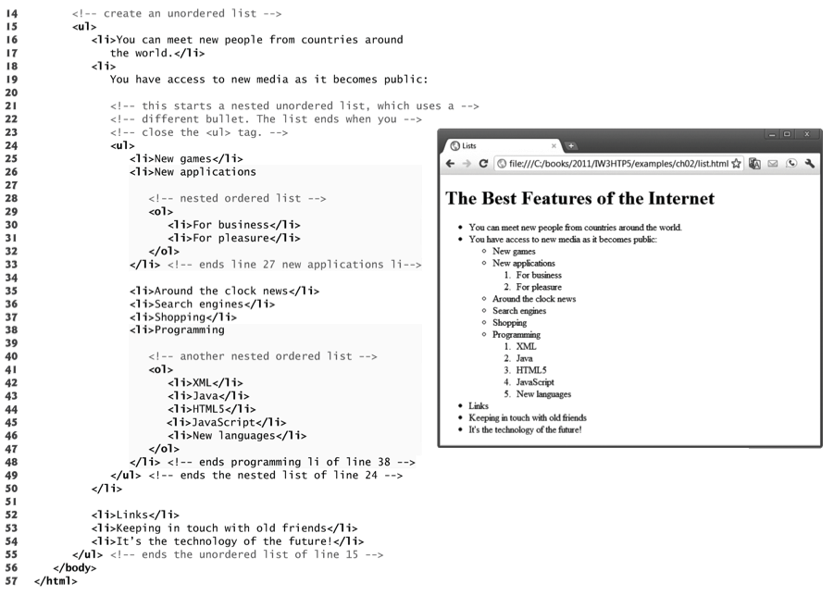
© 2008 Pearson Education, Inc. All rights reserved.

Slide 15
Tables
Tables are frequently used to organize data into rows and columns
The table element defines an HTML5 table
The summary attribute summarizes the table’s contents
Used by speech devices for users with visual impairments
The caption element specifies a table’s title
A table can be split into three distinct sections…
Head
Column titles
Body
Primary table data
Table Foot
Calculation results or footnotes,
Above Table’s Body in code, but displays at bottom of table
tr Element
Defines individual table rows
Element th(td)
Defines a table header(table data) cell
© 2008 Pearson Education, Inc. All rights reserved.
Notes:
It’s good practice to include a general description of a table’s information in the table element’s summary attribute—one of the many HTML5 features that make web pages more accessible to users with disabilities.
Speech devices use this attribute to make the table more accessible to users with visual impairments.

Slide 16
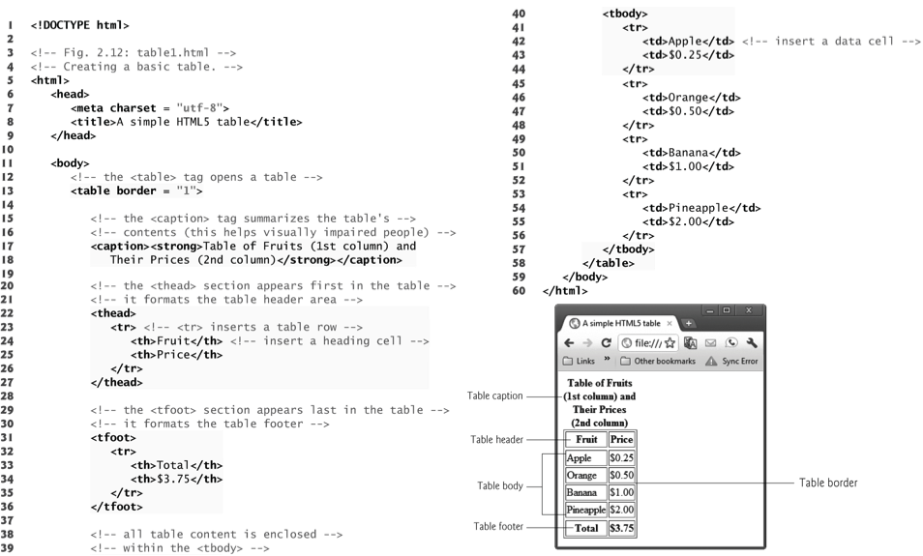
© 2008 Pearson Education, Inc. All rights reserved.

Slide 17
Forms
HTML provides forms for collecting information from users
A form is defined by a form element
Attribute method specifies how the form’s data is sent to the web server
Using method = "post"
Appends form data to the browser’s HTTP request
Using method = "get”
Appends the form data directly to the end of the URL of the script (visible in browser Address field)
Attribute action specifies the script to which the form data will be sent
© 2008 Pearson Education, Inc. All rights reserved.
Notes:
Form Action Attributes
What kind of actions are allowed?
GET, POST
What’s the difference?
GET makes query string out of all input names/values and adds it to the URL
POST makes
?: What’s the difference between the action of a form and the href of an anchor?
Action will go to website and send name/values from form (using get or post)
Href will simply go to website…no info is sent
<form method=“get” action=“http://akaplan.edu/foo.php”>
<input type=“hidden” name=“a” value=“b”>
<input type=“text” name=“c” size=“1” maxlength=“1” value=“4”>
<input type=“reset” value=“Reset”>
<input type=“submit” value=“Submit”>
</form>
What appears in the browser’s address bar if the user presses submit and without changing the textbox?
http://akaplan.edu/foo.php?a=b&c=4

Slide 18
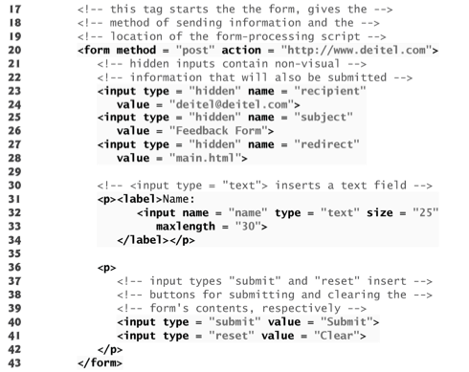
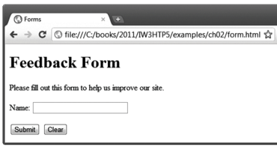
© 2008 Pearson Education, Inc. All rights reserved.

Slide 19
Form Inputs
© 2008 Pearson Education, Inc. All rights reserved.
input elements specify data to provide to the backend
An input’s type is determined by its type attribute
Hidden inputs (type = hidden)
Do not interact with user
Send any data that you specify to backend
Data defined by name/value attributes
Text inputs (type = text)
Size attribute species number of characters visible in text field
Maxlength (optional attribute) limits number of input characters
Submit/Reset inputs (type = submit/reset)
Buttons
Submit button sends data to backend script
Reset button resets all form elements to their default values
The value attribute sets the text displayed on the button
label element
Provides information about the input element’s purpose

Slide 20
Void Elements
Some HTML5 elements (called void elements) contain only attributes and do not mark up text (i.e., text is not placed between a start and an end tag)
You can terminate void elements (such as the img element) by using the forward slash character (/) inside the closing right angle bracket (>) of the start tag
For example, <img…> tag could be written as…
<img src = "jhtp.png" width = "92" height = "120"
alt = "Java How to Program book cover" />
© 2008 Pearson Education, Inc. All rights reserved.

